Slide 1

Cybersecurity Awareness in Online Education: A Case Study Analysis
SIDDHARTH INSTITUTE OF ENGINEERING & TECHNOLOGY (AUTONOMOUS) (Approved by AICTE, New Delhi & Affiliated to JNTUA, Ananthapuramu) (Accredited by NBA for Civil, EEE, Mech., ECE & CSE Accredited by NAAC with ‘A+’ Grade) Puttur -517583, Chittoor District, A.P. (India)
UNDER THE GUIDANCE OF:
MR P.BALAJI ,
ASSOCIATE PROFESSOR,
MCA DEPARTMENT,
SIETK, PUTTUR
PRESENTED BY:
DARA LAVANYA,
21F61F0025,
MCA DEPARTMENT,
SIETK, PUTTUR

Slide 2
Contents
ABSTRACT
INTRODUCTION
SOFTWARE AND HARDWARE REQUIREMENTS
MODULES
MODULES FUNCTIONALITY
SCREENS/INTERFACES
TESTING
CONCLUSION
REFERENCES

Slide 3
ABSTRACT
This study presents to what extent students are knowledgeable about cybersecurity in the distance education process. The survey was conducted with a sample of students from all faculties of the university at the undergraduate, graduate, and PhD levels. Our research study shows that although huge numbers of cyberattacks are occurring around the world, the students did not have any knowledge about cybersecurity and the effects of cyberattacks overall. An analysis of cybersecurity awareness was undertaken by asking questions focused on malicious software, password security, and social media security. Although we live in an age of technology where our entire lives are indexed to the internet through the distance education process, it has been determined that students have a weak cybersecurity awareness. It has been further concluded that cybersecurity education should be given to prevent the students from becoming a victim of cyberattacks, helping them to use the internet more effectively.
Keywords : Students, Online, Education, Cyber Security, Cyber attacks

Slide 4
INTRODUCTION
With the spread of technology and the penetration of the internet into every aspect of daily life, cybersecurity has begun to be of great importance for both individuals and states alike.
Although these innovations have made our lives easier, the increase in cyberattacks has made it necessary to take measures in this area.
Cybersecurity awareness, or information security awareness, has become an important issue today.
The number of studies on this subject, which affects every aspect of daily life, is increasing.
First of all, defining cybersecurity awareness is important to better gain a full understanding of the subject.
As can be understood from the definition, the important points are evaluated in two ways.
Firstly, it emphasizes the importance and responsibilities to do with information security.
Secondly, it is aimed at knowing and applying information security control practices at an adequate level to protect the information.

Slide 5
EXISTING SYSTEM
In Existing system, conducted a study on this subject involving Malaysian students.
They investigated whether the sample of students knew about this subject and whether they had been the victim of this type of fraud.
The results of their survey showed that more than 30% of students had been a victim of a social networking site scam and surveyed cybersecurity awareness among college students.
They found that the students were able to protect themselves from cyber threats and here conducted a survey among undergraduate and graduate students.
The survey was conducted on students from various countries.
The results revealed that internet users are aware of cyber risks and simple precautions are taken by them.
The authors claimed that there is a link between cyber awareness and cyber knowledge.

Slide 6
DISADVANTAGES OF EXISTING SYSTEM
The system is not implemented Security Vulnerabilities And Cyber Threats.
The system is not implemented Awareness Of Cybercrimes And Laws.

Slide 7
PROPOSED SYSTEM
Cybersecurity awareness, or information security awareness, has become an important issue today.
First of all, defining cybersecurity awareness is important to better gain a full understanding of the subject
Defined the concept as; ``the degree of understanding of users about the importance of information security and their responsibilities and acts to exercise sufficient levels of information security control to protect the organization's data and networks‘’.
As can be understood from the definition, the important points are evaluated in two ways.
Firstly, it emphasizes the importance and responsibilities to do with information security.
Secondly, it is aimed at knowing and applying information security control practices at an adequate level to protect the information
On the other hand, defines cybersecurity awareness as a phenomenon that aims to increase the level of knowledge about the online applications
Within the framework of these definitions, it can be clearly seen that security awareness training should be provided to improve cybersecurity awareness.

Slide 8
ADVANTAGES OF PROPOSED SYSTEM
It measures the level of awareness of an ordinary computer user about the risks of cyberattacks, it is important to determine whether they have basic security knowledge.
Since it is predicted that most of the participants are a population that uses passwords, has social media accounts, and installs various software on their computers, the questions were chosen in this direction

Slide 9
HARDWARE REQUIREMENTS
Processor- Intel (R) Core (TM) i3-4200U
CPU - 1.6GHz
RAM:4 GB
Hard Disk: 500 GB.

Slide 10
SOFTWARE REQUIREMENTS
Operating System - Windows 10/11
Server - XAMPP Server
Front End - HTML, CSS, JS
Back End - Python
Data base - MYSQL
IDE - PyCharm
Framework - Django

Slide 11
MODULES
In this proposed system there are two modules they are:
Admin
User

Slide 12
MODULES FUNCTIONALITY
Admin: The following are the functionalities provided by the Admin:
Login
Browse & Train & Test Data sets
View Trained & Tested Accuracy in Bar Chart
View Trained & Tested Accuracy results
View Prediction of Cyber Security Awareness
View Cyber Security Awareness type Ratio
Download Trained Data sets
View Cyber Security Awareness type ratio results
View all users
Log out

Slide 13
MODULES FUNCTIONALITY
Users: The following are the functionalities provided by the User:
Register & Login
Predict Cyber Security Awareness type
View Your Profile
Log Out

Slide 14
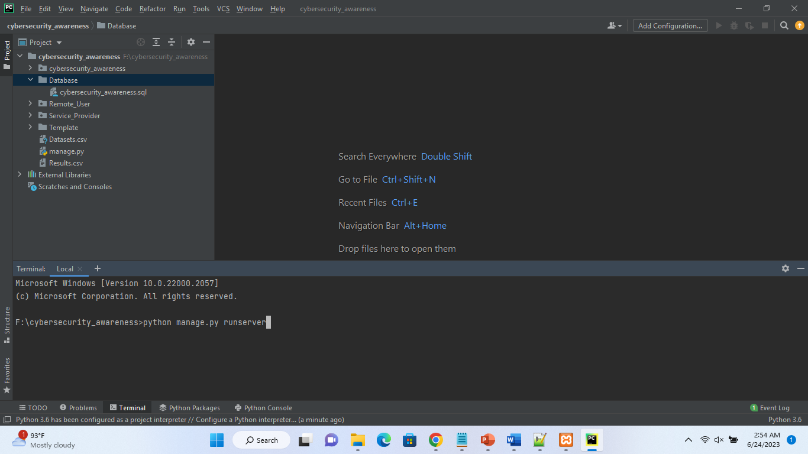
SCREEN/INTERFACES

Slide 15
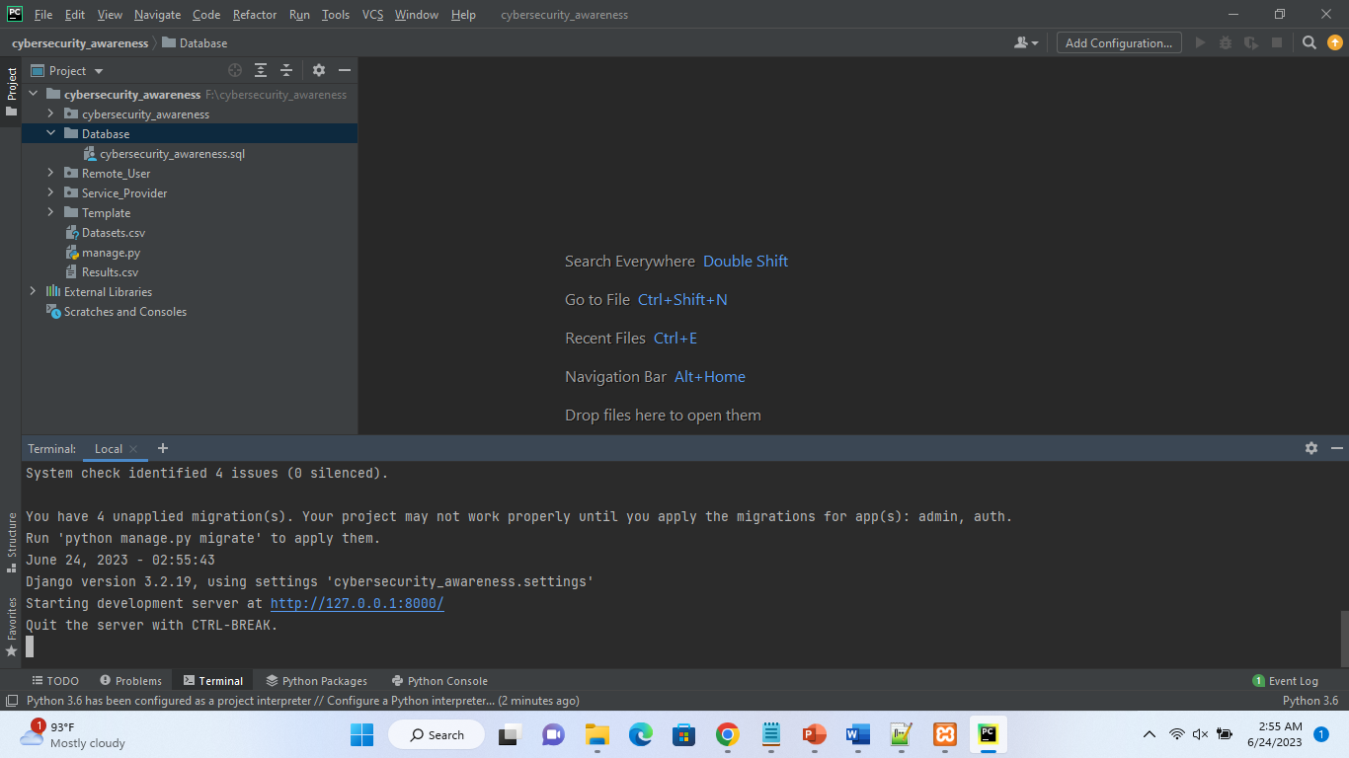
SCREEN/INTERFACES

Slide 16
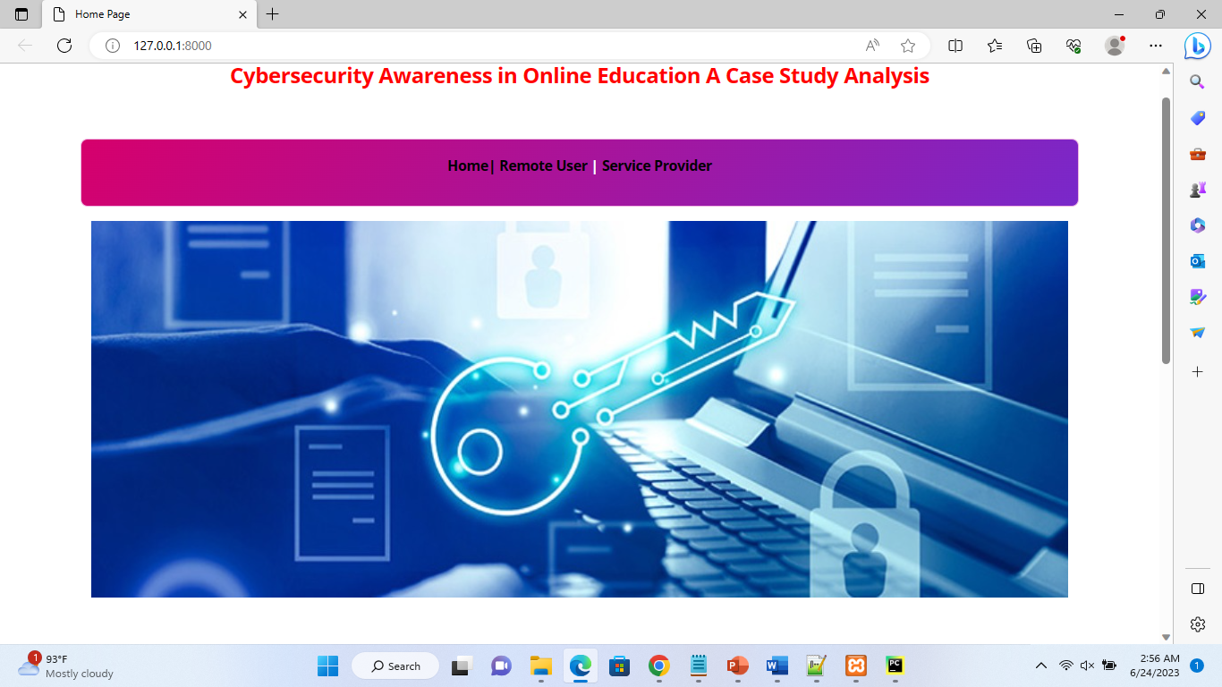
SCREEN/INTERFACES

Slide 17
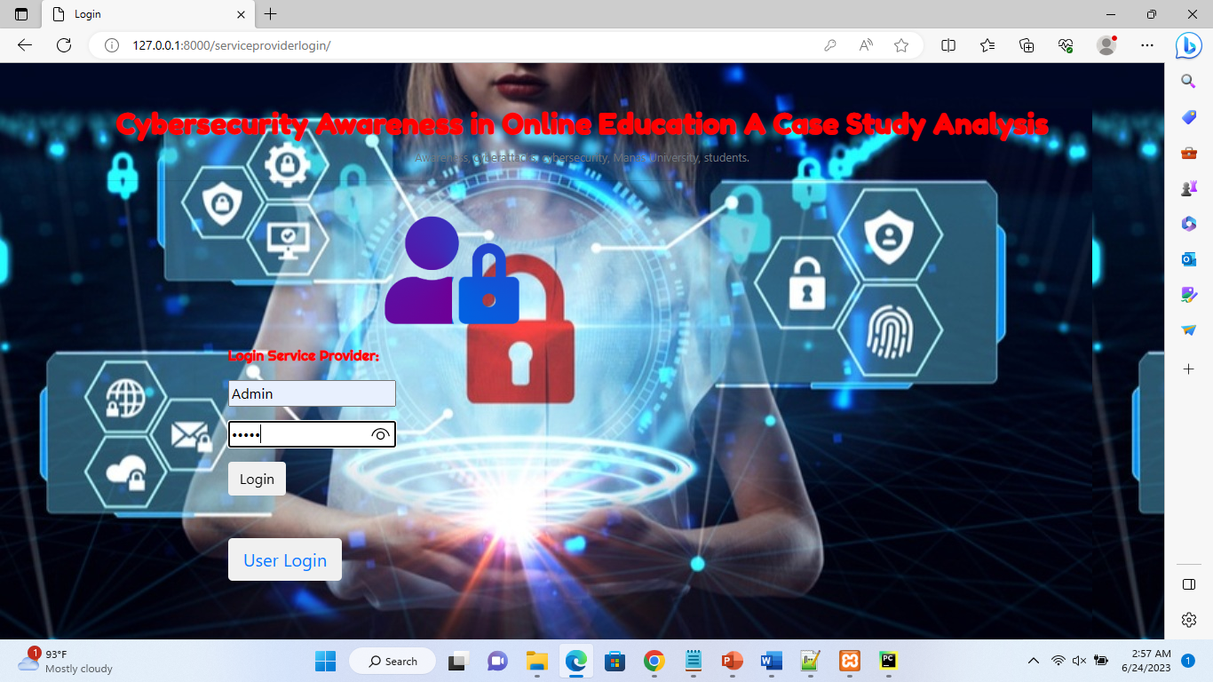
SCREEN/INTERFACES

Slide 18
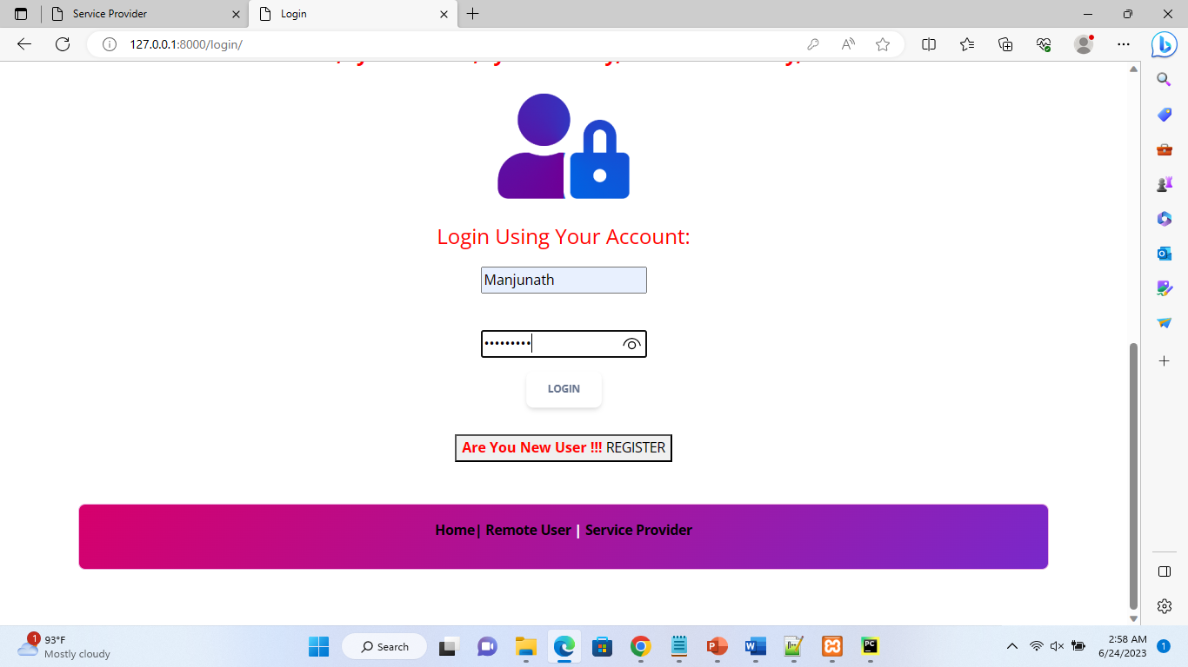
SCREEN/INTERFACES

Slide 19
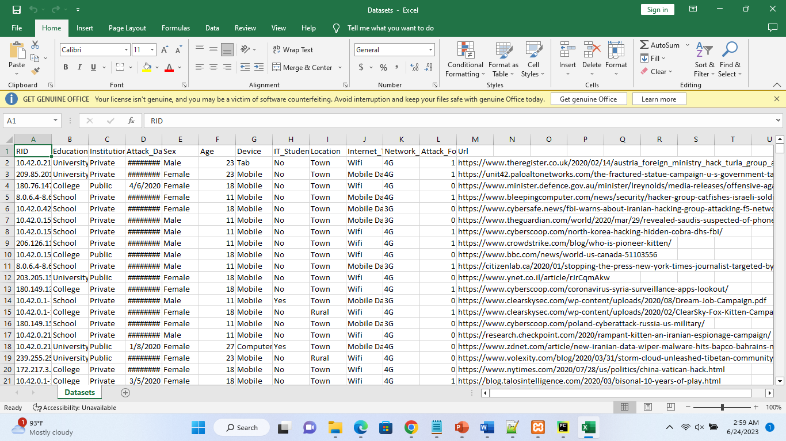
SCREEN/INTERFACES

Slide 20
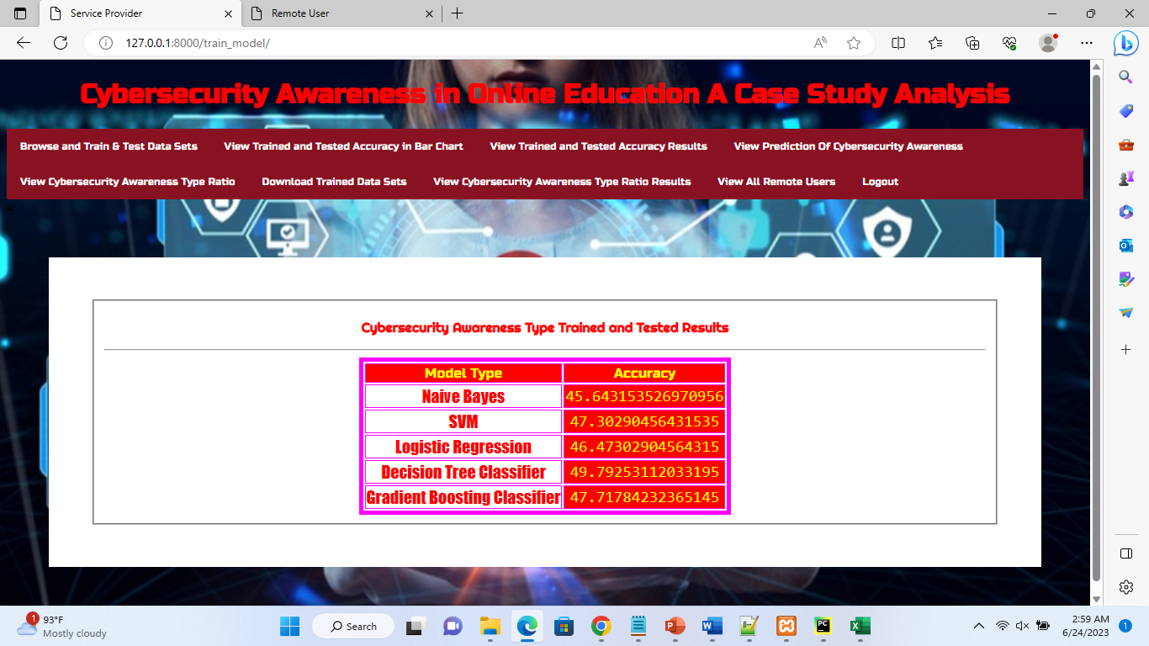
SCREEN/INTERFACES

Slide 21
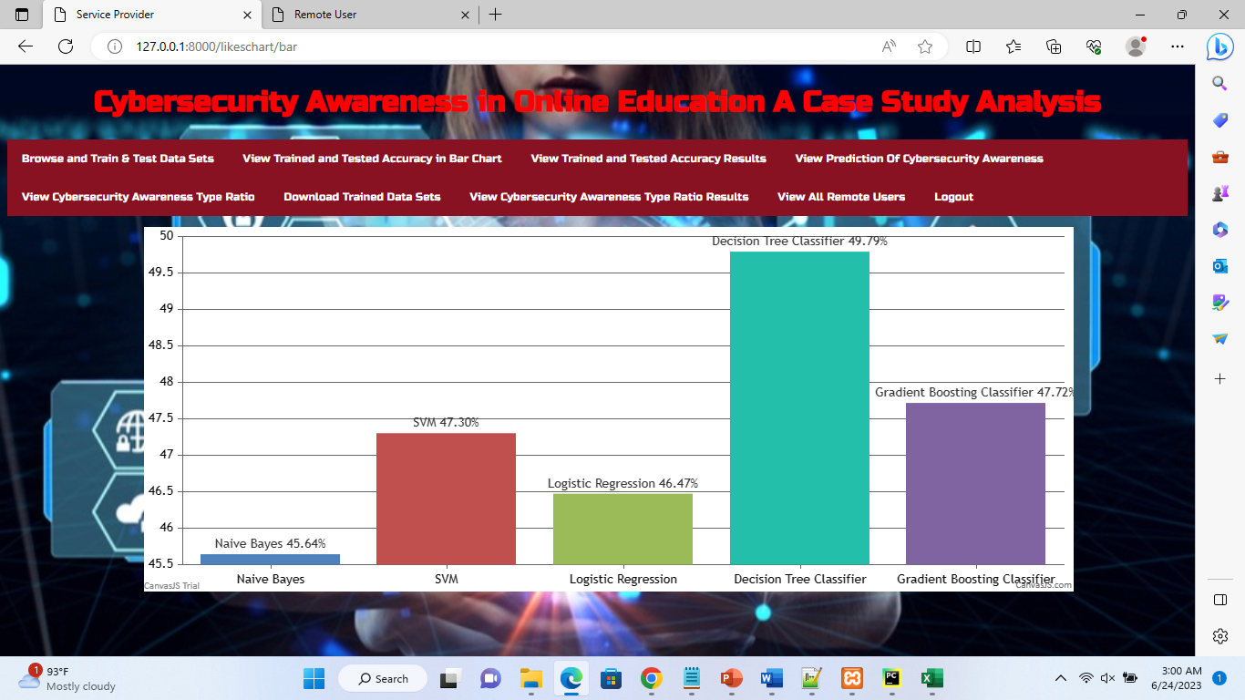
SCREEN/INTERFACES

Slide 22
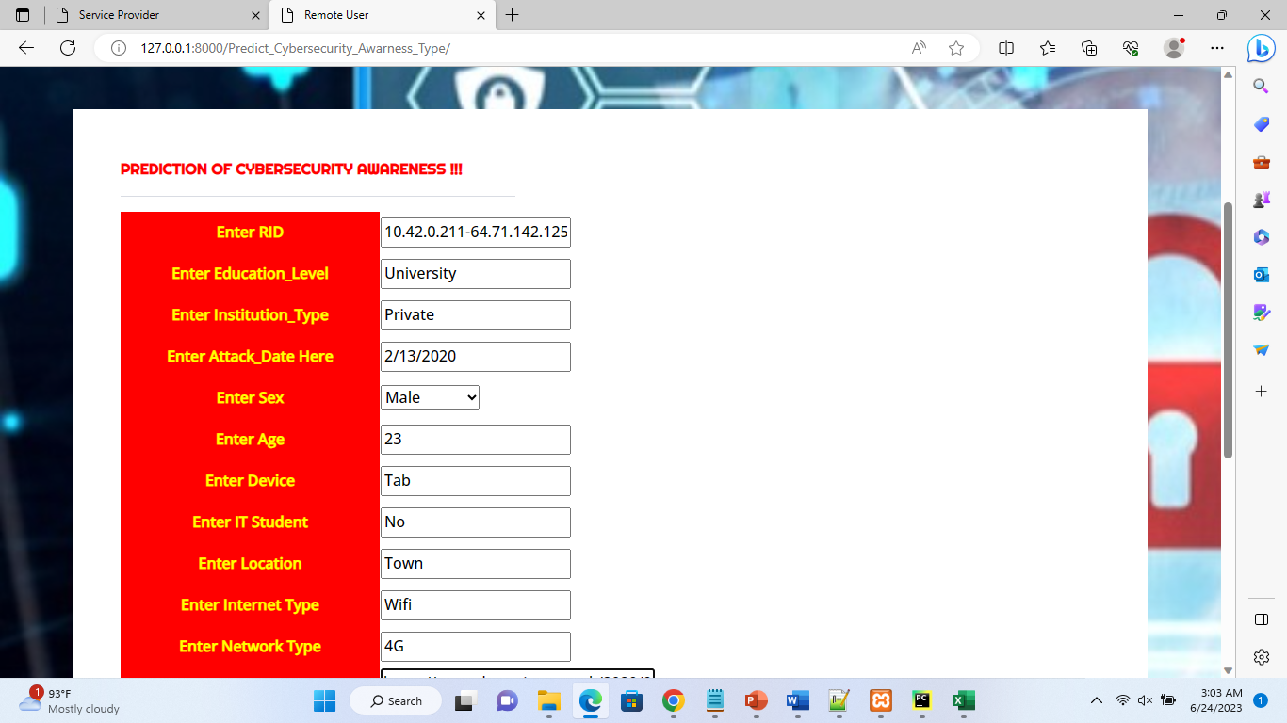
SCREEN/INTERFACES

Slide 23
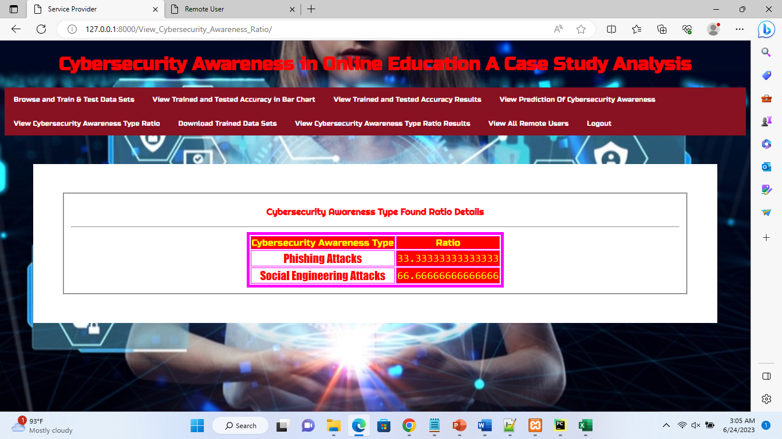
SCREEN/INTERFACES

Slide 24
TESTING
Testing:
Testing is a process of executing a program with the aim of finding error. To make our software perform well it should be error free. If testing is done successfully it will remove all the errors from the software.
Software Testing:
Software testing is a process of identifying the correctness of software by considering its all attributes (Reliability, Scalability, Portability, Re-usability, Usability) and evaluating the execution of software components to find the software bugs or errors or defects.
Testing is mandatory because it will be a dangerous situation if the software fails any of time due to lack of testing. So, without testing software cannot be deployed to the end user.

Slide 25
TESTING STRATEGIES
1. White Box Testing:
Testing technique based on knowledge of the internal logic of an application's code and includes tests like coverage of code statements, branches, paths, conditions. It is performed by software developers.
2. Black Box Testing:
A method of software testing that verifies the functionality of an application without having specific knowledge of the application’s code/internal structure. Tests rebased on requirements and functionality.
3. Unit Testing:
Software verification and validation method in which a programmer tests if individual units of source code are fit for use. It is usually conducted by the development team.

Slide 26
TEST CASES
Test Case-1 :User Registration
Expected Output : User Registration successful
Actual Output :User Registration is successful as user entered correct format in email id field
2.Test Case-2:Admin Home Page
Expected Output :Admin Home Page is successful and Admin main menu is displayed
Actual Out2. Test Case-2 :When Admin username and Password is entered into login page. On Successful credentials, Admin home page is displayed and main menu is displayed in Admin home page
3. Test Case-3 :Prediction Result
Expected Output :Prediction result will be cyberattack type
Actual Output :Prediction result is not returned as the parameter is not given correctly

Slide 27
Conclusion
Our research study shows that although huge numbers of cyberattacks are occurring around the world, the students did not have any knowledge about cybersecurity and the effects of cyberattacks overall. It has been further concluded that cybersecurity education should be given to prevent the students from becoming a victim of cyberattacks, helping them to use the internet more effectively.
.

Slide 28


